Slide 1

Data Scientist on the Move!
Examining Salary and Cost of Living in the US
Jedi Scientists
Mindy Bartlett
Christina Wang
Alexander Buitron
Harry Wang
Notes:
Introduction
**Speaker Note text in BLUE is intended to be covered verbally and may not have presentation visual

Slide 2
Project Purpose: Discover Profitable Locations for Data Scientist to Live
Discoveries to Make of our Data:
Which 10 cities in the US currently have the highest average salary for Data Scientists?
Which 10 cities have the highest ‘net living’ for a single Data Scientist?
Of the top 3 cities, what are the ‘quality of life’ factors?
Of the top 3 cities, how do the cost of living components compare to the designated benchmark?
Which 10 cities have the highest ‘net living’ for a Data Scientist with a family of four
Of the top 3 cities, what are the ‘quality of life’ factors?
Of the top 3 cities, how do the cost of living components compare to the designated benchmark?
Notes:
Define the core message or hypothesis of your project.
Describe the questions you asked, and why you asked them
Describe whether you were able to answer these questions to your satisfaction, and briefly summarize your findings
Elaborate on the questions you asked, describing what kinds of data you needed to answer them, and where you found it

Slide 3


Data Sources
Payscale.com : Web scraping to gather Data Scientist salaries for all records in the United States.
Numbeo API: Used API to gather detailed information related to cost of living as well as quality of life factors in the cities and surrounding areas where Data Scientist are represented.
Notes:
Add snippets or other visual interest if more notes are not needed or available

Slide 4
Data Gathering, Cleaning and Organizing
Scraping: Use of the python module BeautifulSoup4 to scrape from Payscale to gather the salary data for Data Scientists across the US.
Regional Data: Gather data on the cities that match up with cities that have DS salary data as well as cities within 100km from (~60mi) from those city centers.
Machine Learning: fit a linear regression classifier to multiple features in order to build a model that effectively determined the missing cost of living values with an R-squared value of 96.1319 %.
Normalizing: The data returned from numbeo’s API used New York as a benchmark to normalize most of its indices. We decided to modify this default benchmark so that our target audience, our beloved cohort, will better understand it. To do this we modified the data to use Los Angeles as the benchmark.
Converting: Using Numbeo’s built-in app we created profiles for a “single Data Scientist” and a “Data Scientist with a family of four”. With those profiles we converted our normalized data into monetary values.
Notes:
Exploitation process, including some deadend sources, Brief exploration of Notebook o
Data Cleanup & Exploration
Describe the exploration and cleanup process
Discuss insights you had while exploring the data that you didn't anticipate
Discuss any problems that arose after exploring the data, and how you resolved them
Present and discuss interesting figures developed during exploration, ideally with the help of Jupyter Notebook

Slide 5
Profiles
Profile Questions: | Single DS | Family Ds
1).Members of your household: | 1 | 4
2).Eating lunch or dinner in restaurants: | 50% of the time | 25% of the time
3).When eating in restaurants you are choosing inexpensive restaurants: | 80% of the time | 30% of the time
4).Drinking Coffee outside of your home: | High | High
5).Going out (cinema, nightlife, etc.): | once per week per household member | twice per month per household member
6).Smoking (household overall): | 0 packs of cigarettes per day | 0 packs of cigarettes per day
7).Alcoholic beverages (consume): | Moderate | Low
8).At home we are eating: | Western food | Western food
9).Driving car: | Moderate | Moderate
10).Taking Taxi: | No | No
11).Paying for public transport tickets: | None | None
12).Sport Memberships: | No | 2 Household members
13).Vacation and Travel: | Two per year (one week each) relatively expensive | Once per year (one week each) relatively expensive
14).Buying Clothing and Shoes: | Moderate | Moderate
Notes:
Data Analysis
Discuss the steps you took to analyze the data and answer each question you asked in your proposal
Present and discuss interesting figures developed during analysis, ideally with the help of Jupyter Notebook

Slide 6
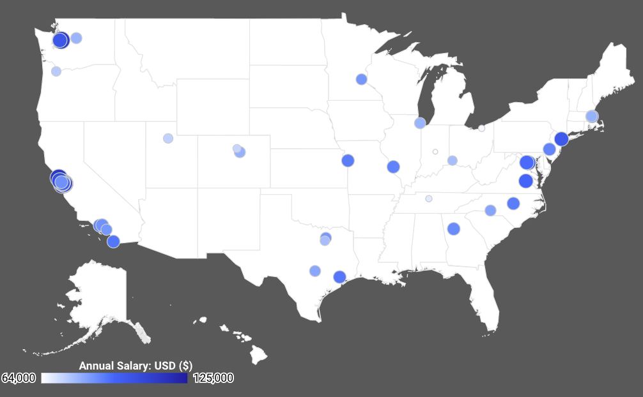
Data Analysis (DA): Data Overview
1 | Cupertino | $125,000.00
2 | San Jose | $117,109.79
3 | Palo Alto | $114,109.51
4 | San Francisco | $114,060.42
5 | Bellevue | $111,968.75
6 | Santa Clara | $109,926.79
7 | San Mateo | $104,804.68
8 | Mountain View | $103,042.00
9 | Seattle | $100,529.55
10 | New York | $99,199.95
Notes:
Question 1: Top ten by Salary:
California Cupertino $125,000.00
California Irvine $85,295.36
California Los Angeles $86,269.74
California Menlo Park $86,400.00
California Mountain View $103,042.00
California Palo Alto $114,109.51
California San Diego $91,324.00
California San Francisco $114,060.42
California San Jose $117,109.79
California San Mateo $104,804.68
Discuss your findings. Did you find what you expected to find? If not, why not? What inferences or general conclusions can you draw from your analysis?

Slide 7
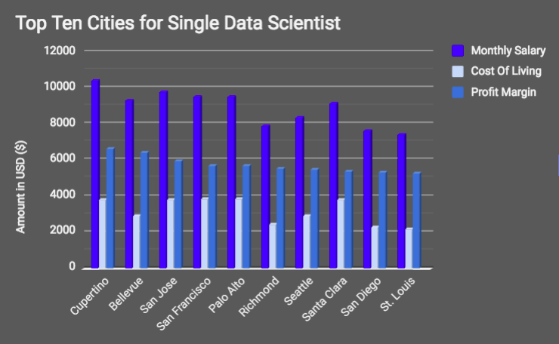
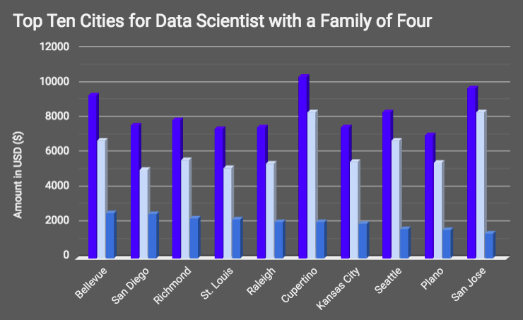
DA: Top Ten Cities for a Data Scientist

Slide 8
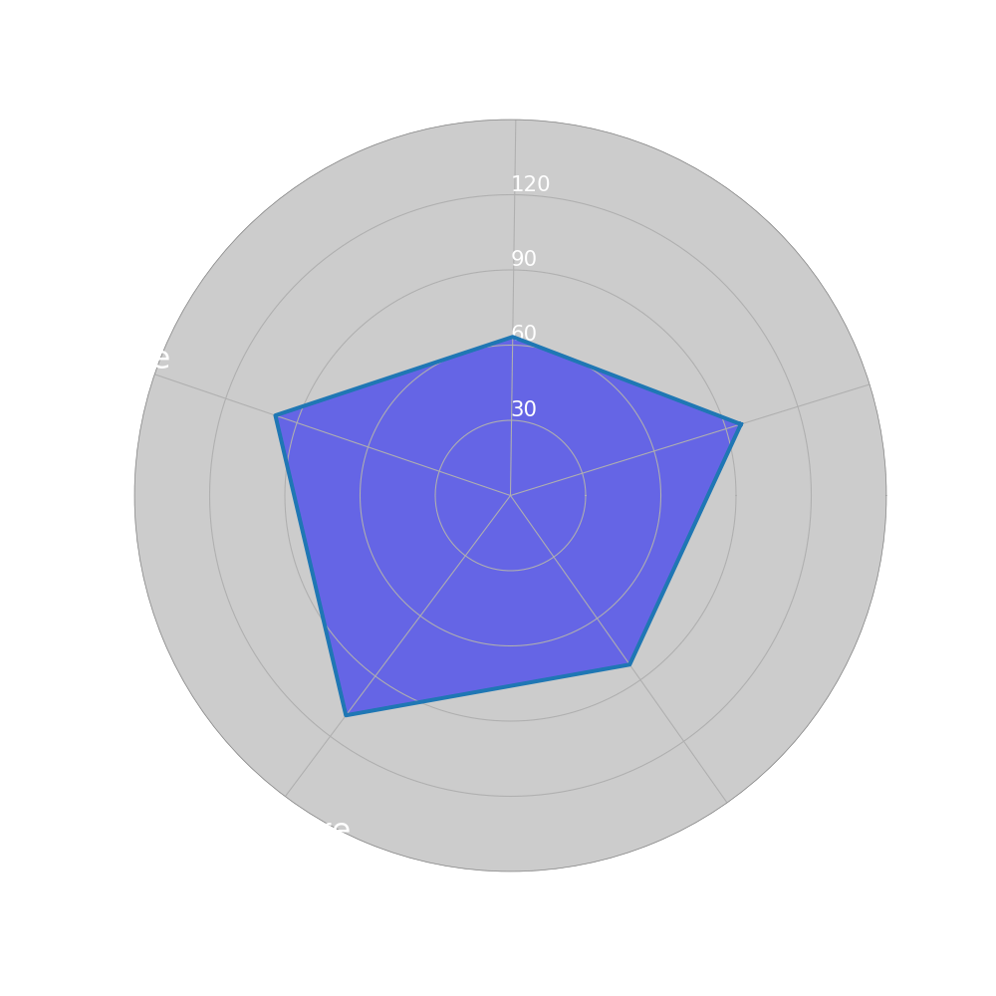
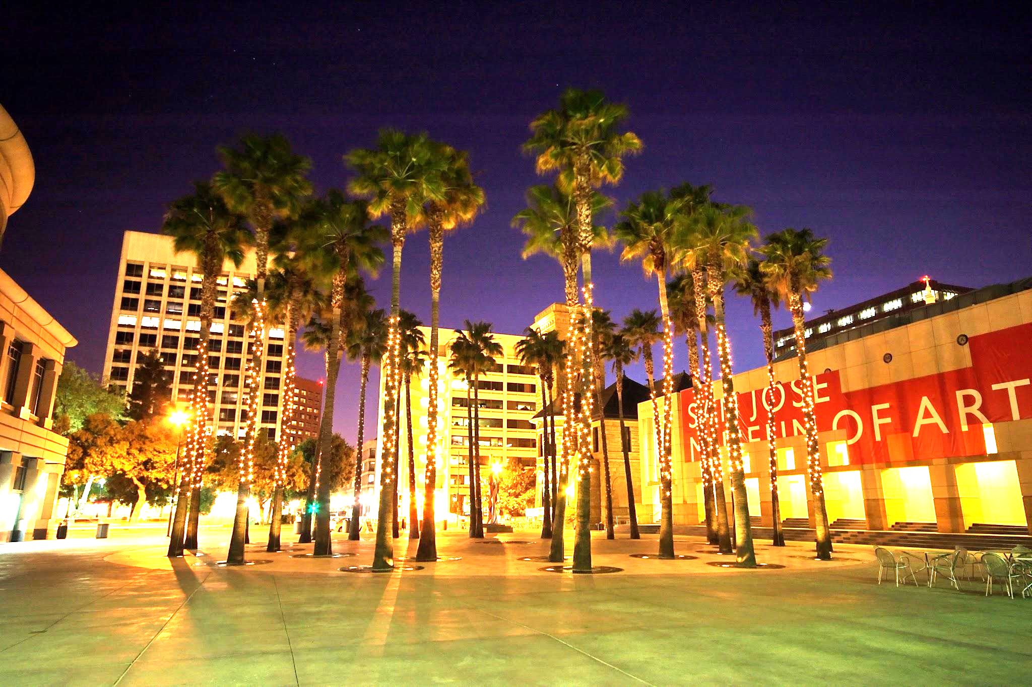
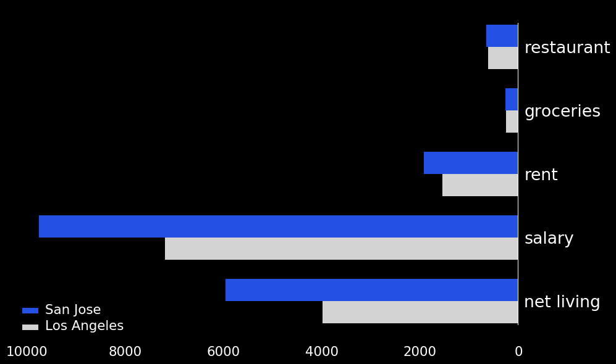
DA: Top Three Cities for a Single Data Scientist
City # 3: San Jose, CA
Restaurant: $660 Groceries: $267 Rent: $1,920 Salary: $9,759 Net Living: $5,959
Center of Silicon Valley
Considered most diverse among 100 largest metros
Access to State and National Forest and beautiful coastline
Bay Area transit makes all surrounding metros easily accessible

Slide 9
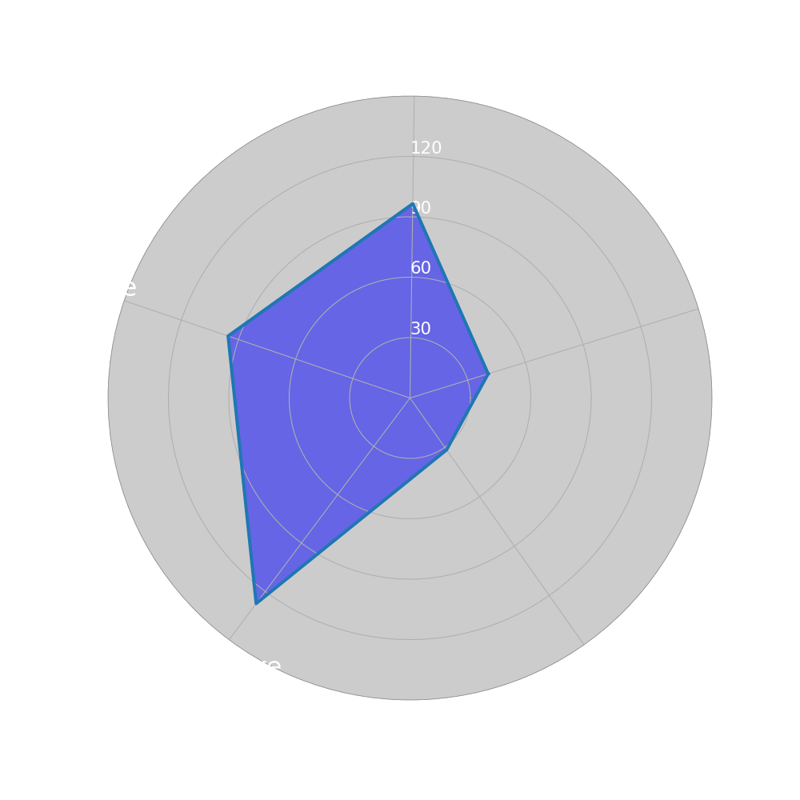
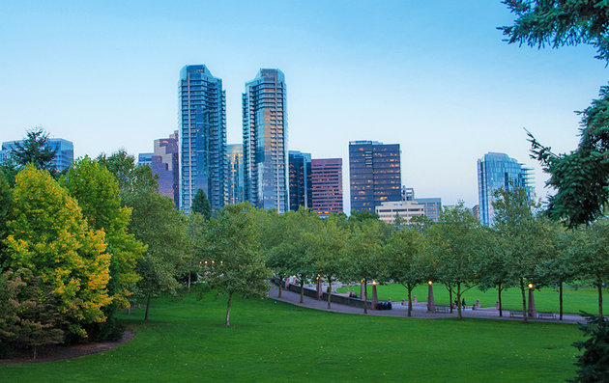
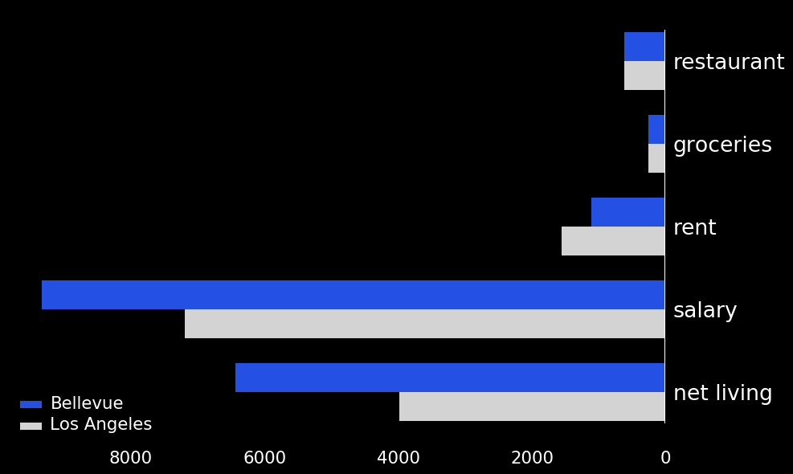
DA: Top Three Cities for a Single Data Scientist
City # 2: Bellevue, WA
Restaurant: $624 Groceries: $259 Rent: $1,110 Salary: $9,331 Net Living: $6,433
Seattle satellite city
Variety of parks and outdoor activities
Downtown is the business epicenter that is also home to vibrant food scene and thriving nightlife

Slide 10
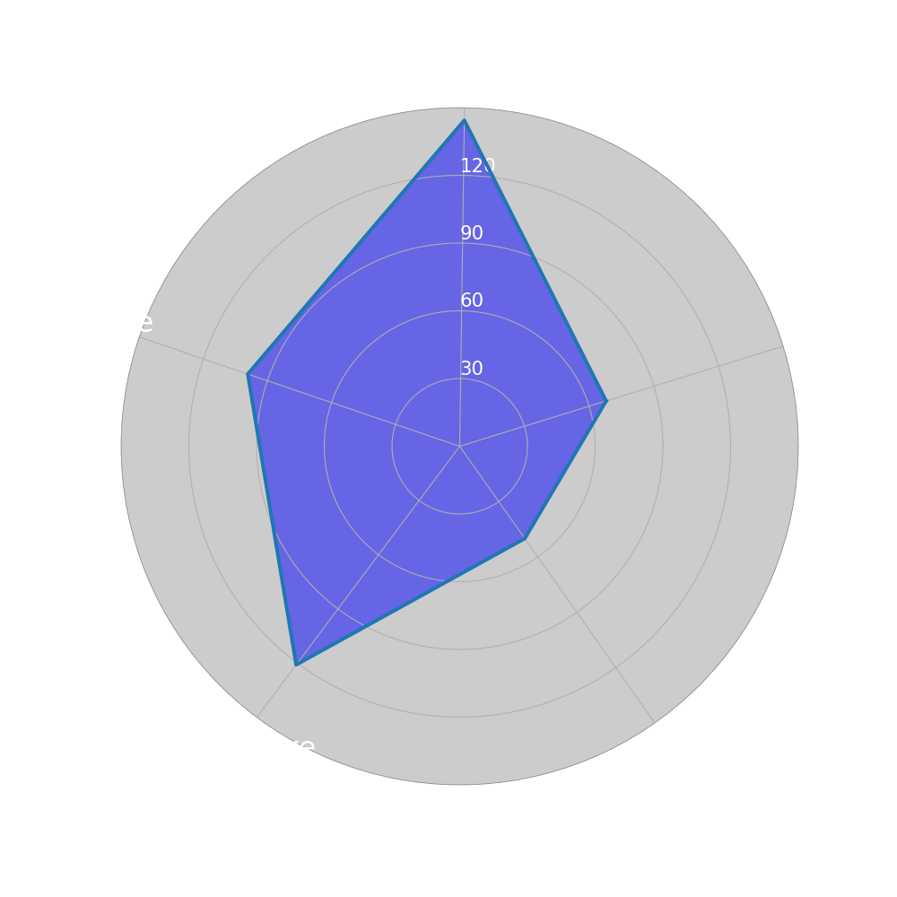
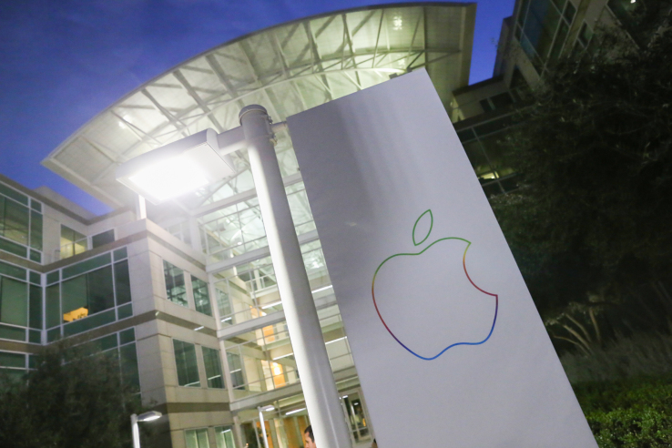
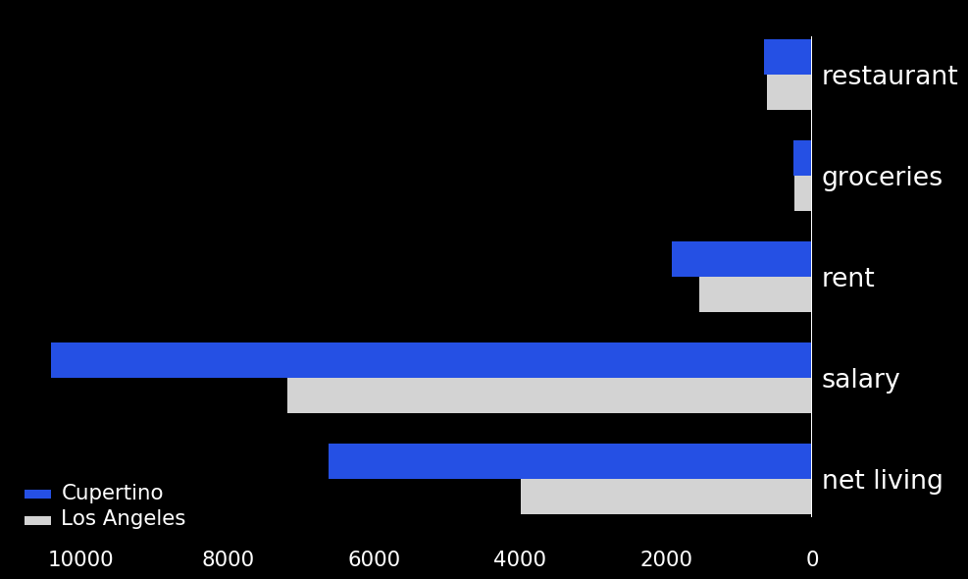
DA: Top Three Cities for a Single Data Scientist
City # 1: Cupertino, CA
Restaurant: $660 Groceries: $267 Rent: $1,920 Salary: $10,417 Net Living: $6,616
Headquarters of Apple
Home to many parks and open space preserves
Proximity to San Francisco provides wealth of events and nightlife

Slide 11
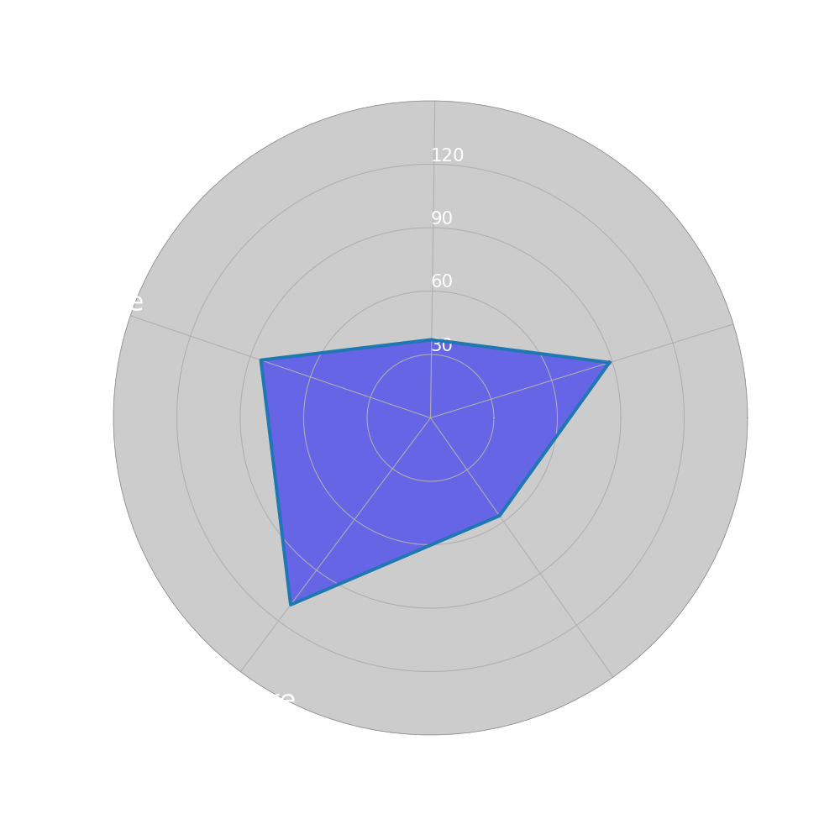

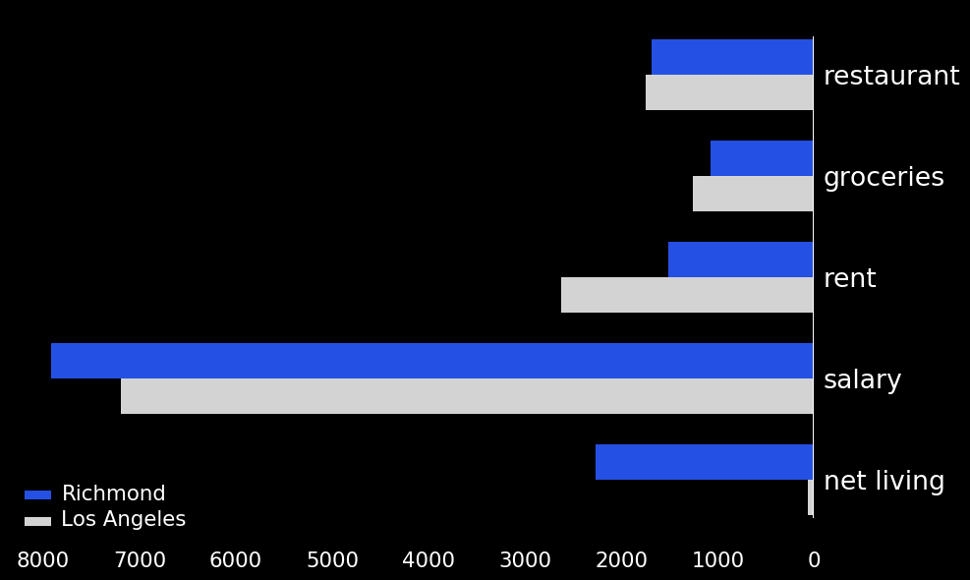
DA: Top Three Cities for a Data Scientist w/a Family
City # 3: Richmond, VA
Restaurant: $1,690 Groceries: $1,078 Rent: $1,515 Salary: $7,917 Net Living: $2,270
Among America’s oldest major cities and rich American history
World-class museums, a vibrant food scene and a wide array of family-friendly entertainment
More than 100 local parks and Kings Dominion amusement park

Slide 12
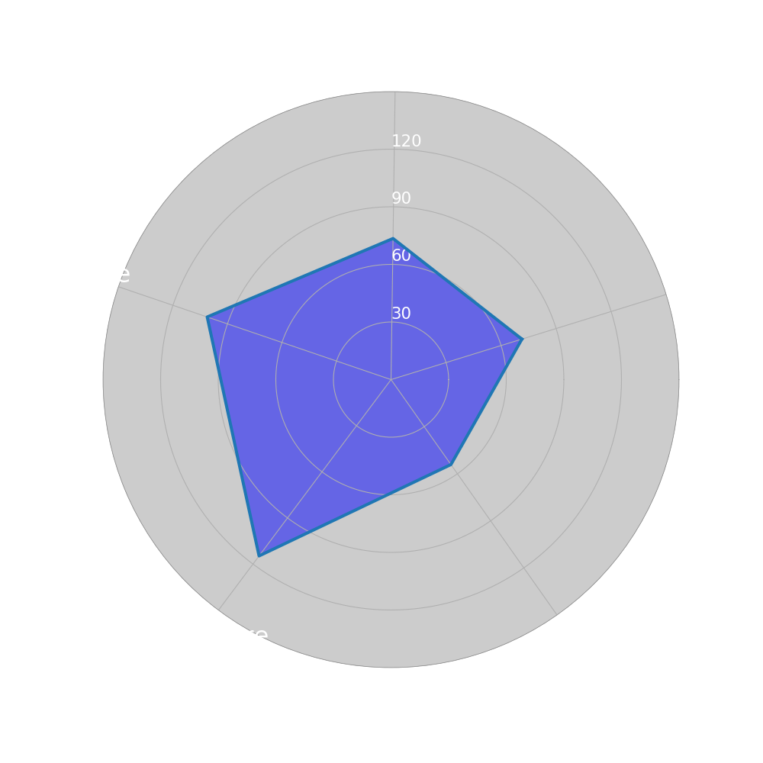
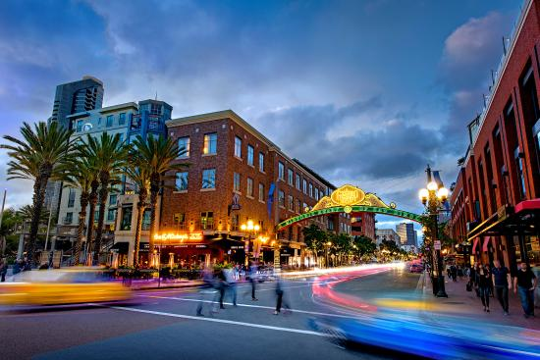
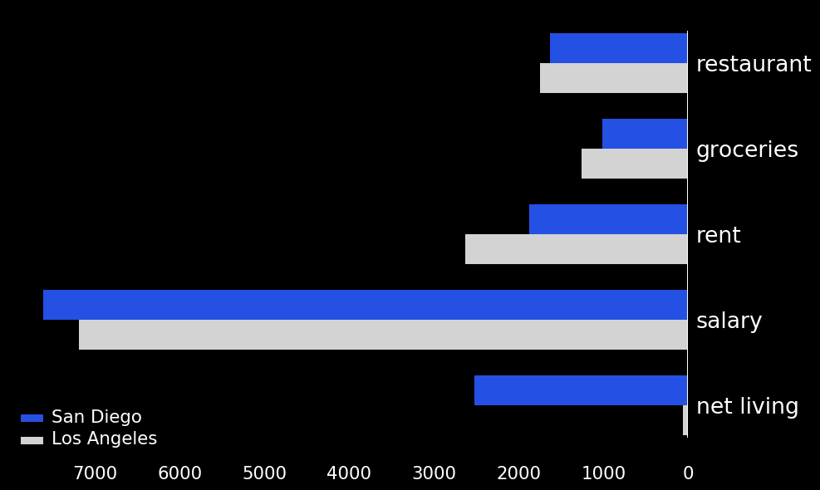
DA: Top Three Cities for a Data Scientist w/a Family
City # 2: San Diego, CA
Restaurant: $1,633 Groceries: $1,016 Rent: $1,875 Salary: $7,610 Net Living: $2,522
Distinct neighborhoods fosters strong community ties with festivals and farmers markets
Beaches, parks, warm climate.
Balboa Park is the site of the renowned San Diego Zoo, as well as numerous art galleries, artist studios, museums and gardens.
Notes:
Add bar plot
Add chart of top n citites data

Slide 13
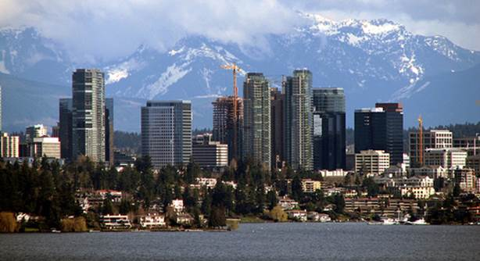
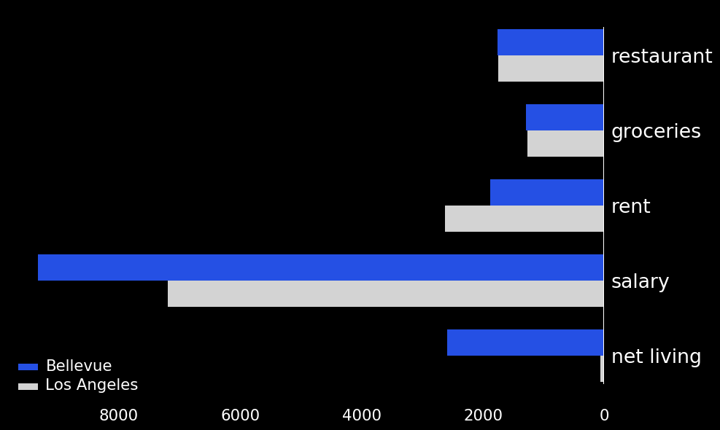
DA: Top Three Cities for a Data Scientist w/a Family
City # 1: Bellevue, WA
Restaurant: $1,755 Groceries: $1,294 Rent: $1,878 Salary: $9,331 Net Living: $2,586
Thriving downtown business district while maintaining a small-town feel
With nearly 100 parks, Bellevue is known as "a city in a park."
The city's crime rates are consistently low and rated one of the best places to live

Slide 14
Post Mortem
Greatest Challenges and Course of Action:
Data Gathering:
Finding data set with Data Scientist salaries
Normalizing Data
Additional Questions, next level project:
How could ‘quality of life’ factors impact outcome of the top cities?
Gather and analyze relevant time series data
Use machine learning to predict future rankings and factors
Notes:
Post Mortem
Discuss any difficulties that arose, and how you dealt with them
Discuss any additional questions that came up, but which you didn't have time to answer: What would you research next, if you had two more weeks?

Slide 15
For More Information on this Project:
Github: https://github.com/buitron/ds_team_project1 Dynamic Data Visualization: https://datastudio.google.com/open/1wSZa1h_qw7FO1sFErgx-Pyi1XMFVKy6G

